Slide 1
Natural Language Processing with Python
Eddy
eddyhu71@gmail.com
https://github.com/EddyHu71

Slide 2


Slide 3


Slide 4
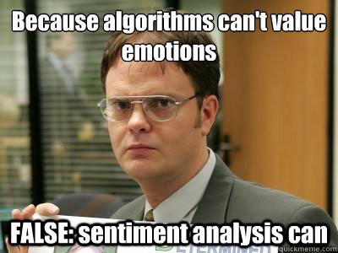
Sentiment Analysis

Slide 5
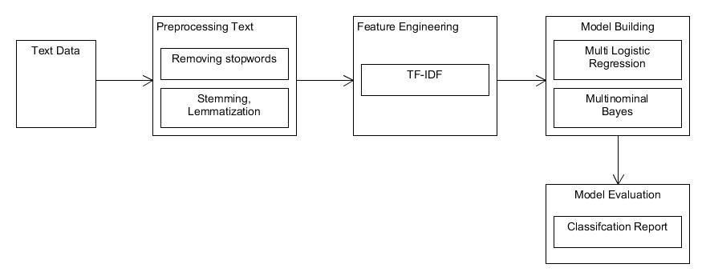
Sentiment Analysis WorkFlow

Slide 6
Feature Engineering

Slide 7
TF-IDF

Slide 8

Term Frequency (TF)
A method to count the weight of word that used in a text / sentence.
$$tf=\{\begin{matrix}1+\log_{10}\left(f_{t_{1}d}\right), \\ 0,\end{matrix} \begin{matrix}f_{t_{1}d}>0 \\ f_{t_{1}d}=0\end{matrix}$$

Slide 9

Inverse Document Frequency (IDF)
How term distributed widely in document.
$${IDF}_{j}=\log{\frac{D}{{df}_{1}}}$$

Slide 10
So, what is TF-IDF?

Slide 11
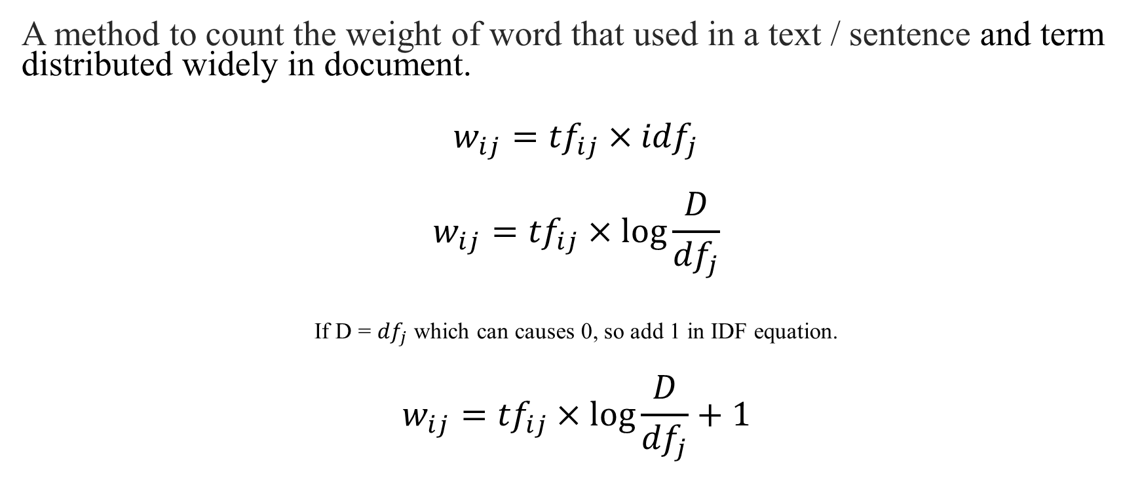
TF-IDF
A method to count the weight of word that used in a text / sentence and term distributed widely in document.
$$w_{ij}={tf}_{ij}×{idf}_{j}$$
$$w_{ij}={tf}_{ij}×\log{\frac{D}{{df}_{j}}}$$
If D = ${df}_{j}$ which can causes 0, so add 1 in IDF equation.
$$w_{ij}={tf}_{ij}×\log{\frac{D}{{df}_{j}}+1}$$

Slide 12
Multinominal Logistic Regression

Slide 13

Linear Regression
The output is prediction.
The output of data type usually continuous.
$$y=b_{0}x+b_{1}$$

Slide 14
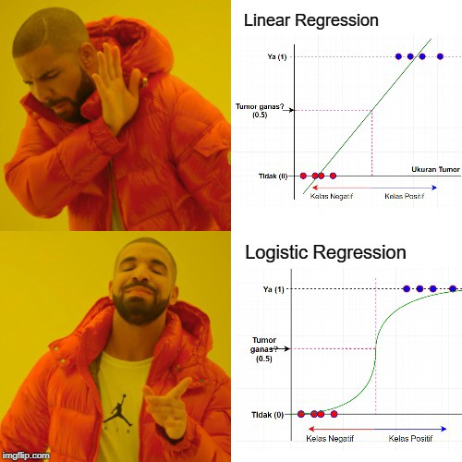

Slide 15
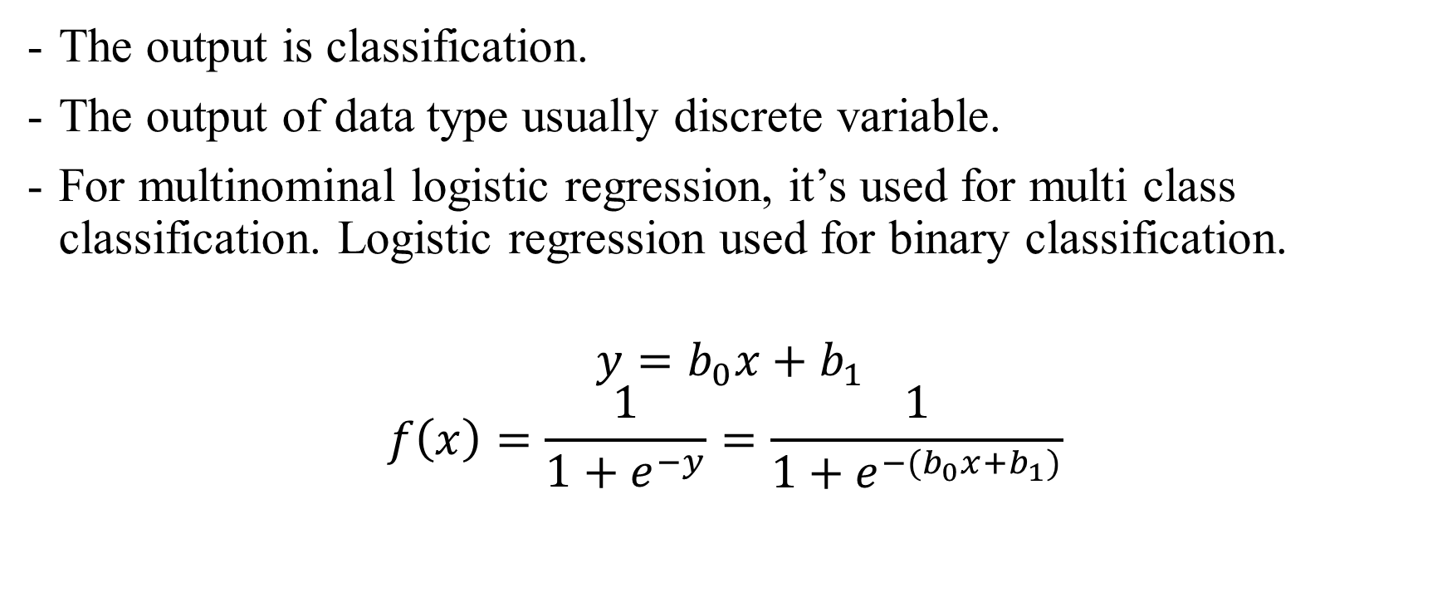
Logistic Regression
The output is classification.
The output of data type usually discrete variable.
For multinominal logistic regression, it’s used for multi class classification. Logistic regression used for binary classification.
$$y=b_{0}x+b_{1}$$
$$f\left(x\right)=\frac{1}{1+e^{−y}}=\frac{1}{1+e^{−(b_{0}x+b_{1})}}$$

Slide 16
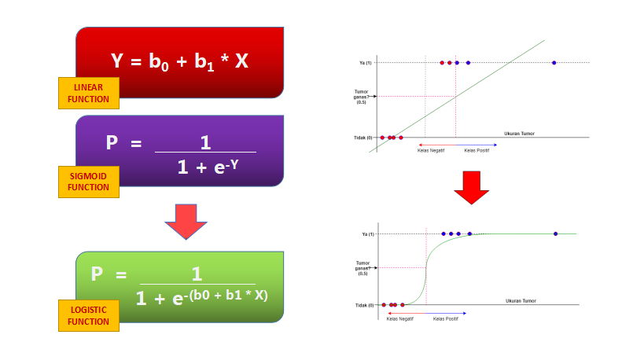

Slide 17
Let’s code

